Slide 1
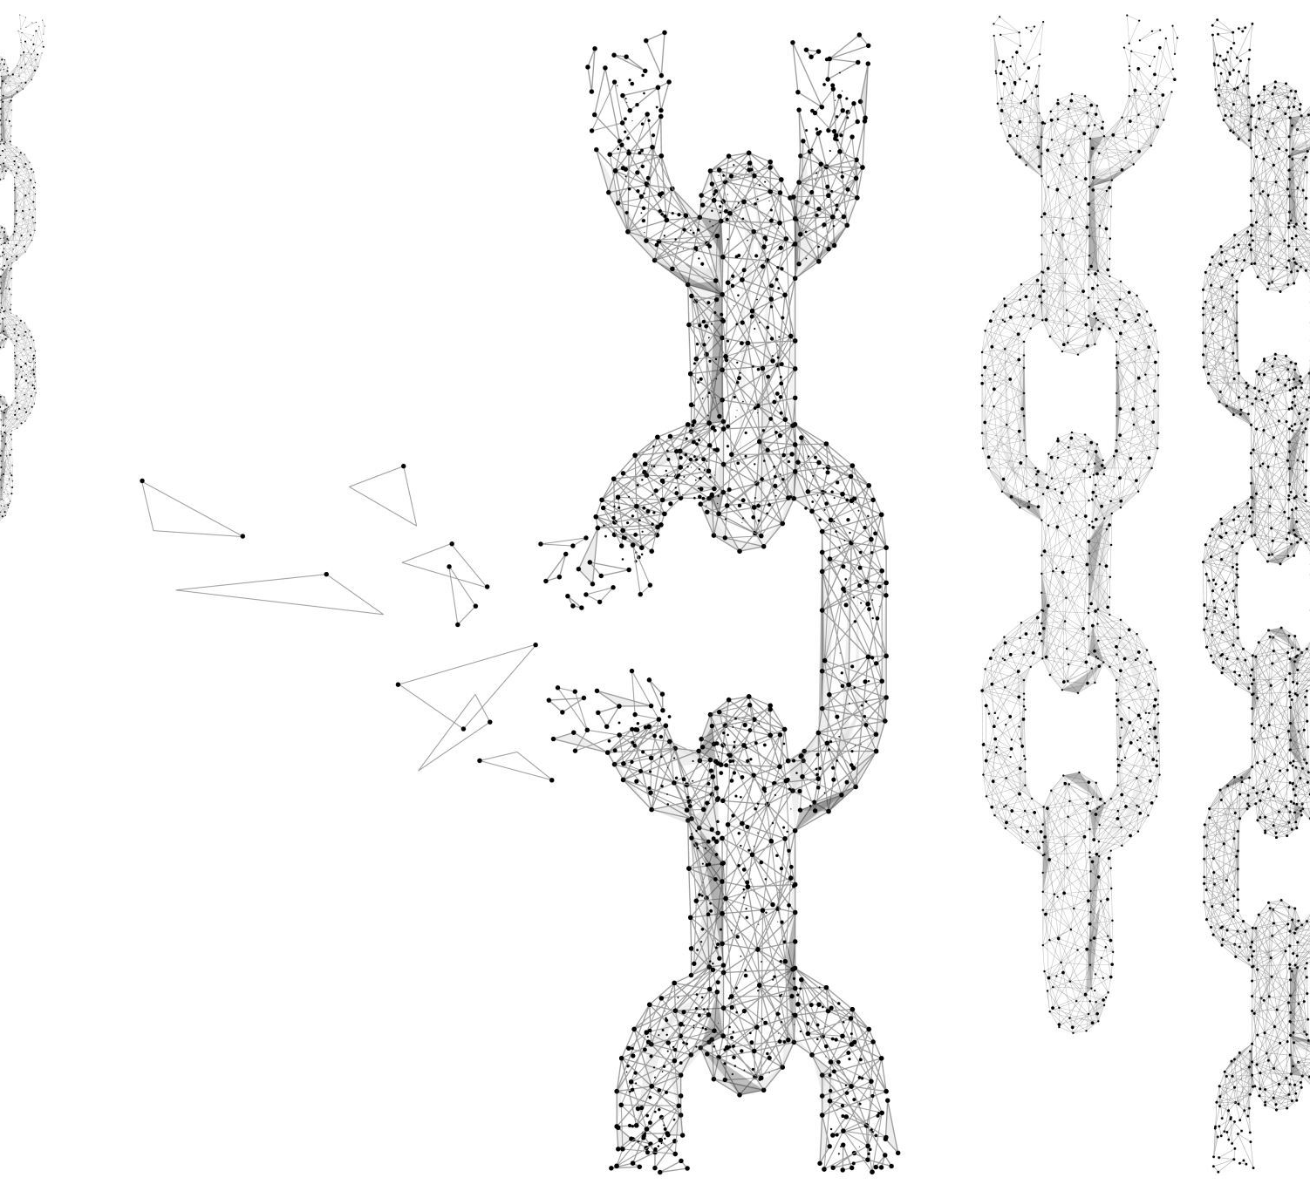

Fundementals and Advanced Concepts of Blockchain
Guest Lecturer : Çağatay Akkaş

Slide 2
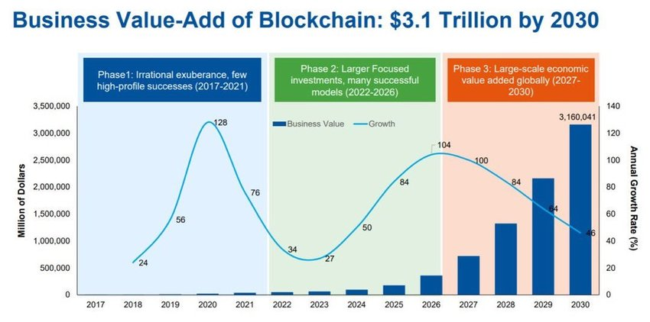
How popular is blockchain

Slide 3
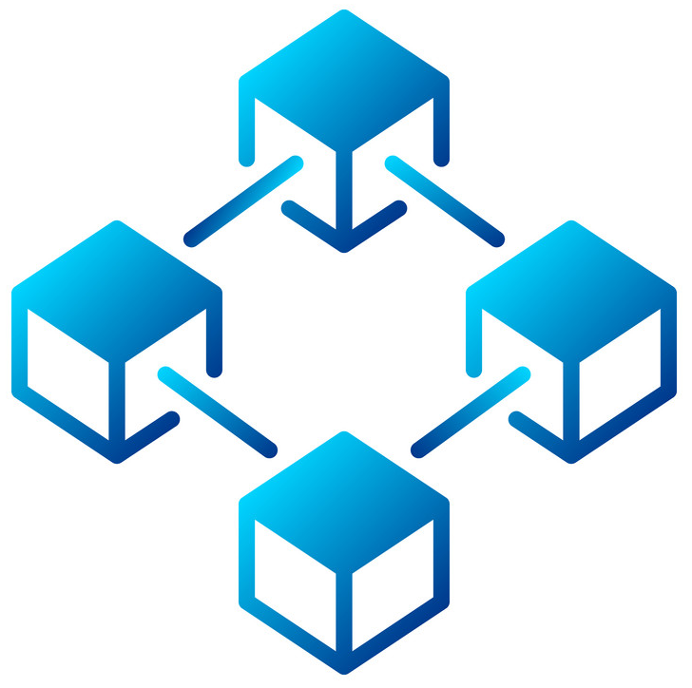
Why We Need Blockchain?
The ability to conduct transactions without relying on trusted third parties, protecting the privacy of users by not requiring the disclosure of personal information, and enabling anonymous transactions. By leveraging cryptography and hashing algorithms, blockchain networks provide high levels of security, preventing tampering or modification of data without detection.These benefits make blockchain technology an attractive option for various industries.

Slide 4

What is blockchain?

Slide 5

Blockchain
Blockchain is a decentralized, transparent, and secure distributed ledger technology that uses cryptography to ensure the integrity and security of the data. It consists of a chain of blocks containing verified transactions, which enables multiple parties to have a copy of a shared database without the need for intermediaries. Blockchain has a wide range of potential applications in areas such as finance, supply chain management, and healthcare.

Slide 6
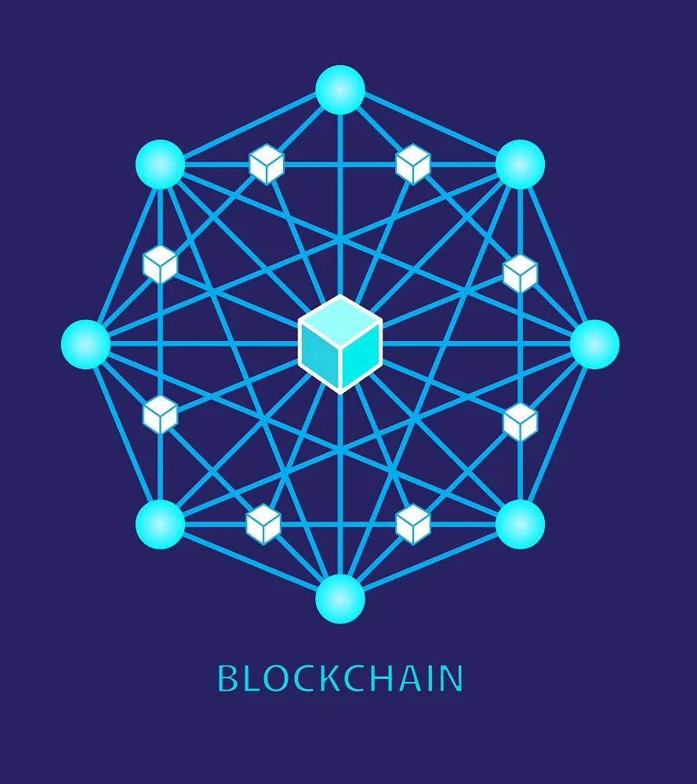
Decentralization
Decentralization refers to the distribution of power and control away from a single central entity, organization, or individual towards a network of nodes or participants. In a decentralized system, each participant has an equal say in the decision-making process and can independently verify and validate transactions and data without the need for intermediaries or trusted third parties.

Slide 7

Transparency
Transparency is a fundamental characteristic of blockchain technology. In a blockchain network, all transactions and data are recorded on a public ledger that can be accessed and viewed by anyone. This enables a high level of transparency and accountability, as every participant can independently verify and validate the data without the need for intermediaries or trusted third parties. The transparency of blockchain also enhances the security and trust of the system, as it reduces the risk of fraud, corruption, or tampering with data.

Slide 8
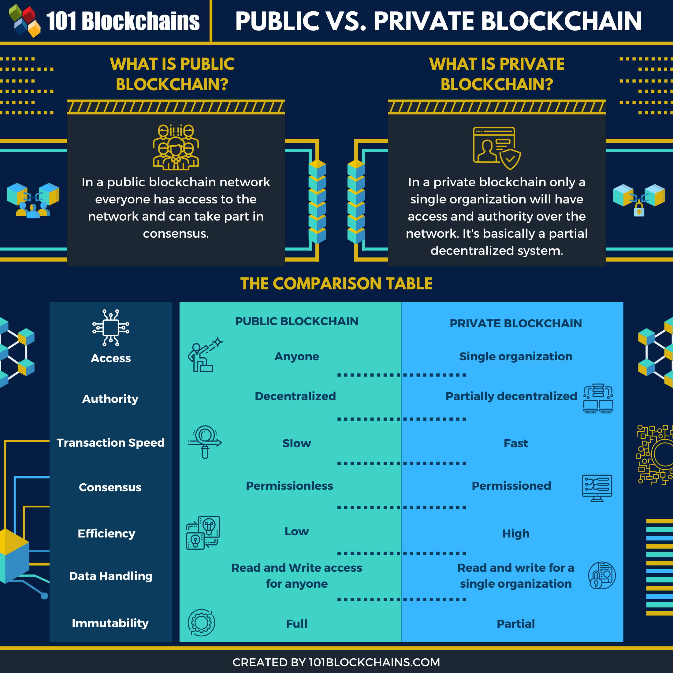
Public and Private Blockchains
Public blockchains are decentralized and transparent, while private blockchains provide greater control and privacy. Public blockchains are open to anyone and are slower and less scalable than private ones, which are only accessible to a select group of users and are faster and more scalable. The choice depends on the use case and desired balance between decentralization, accessibility, control, and scalability.

Slide 9
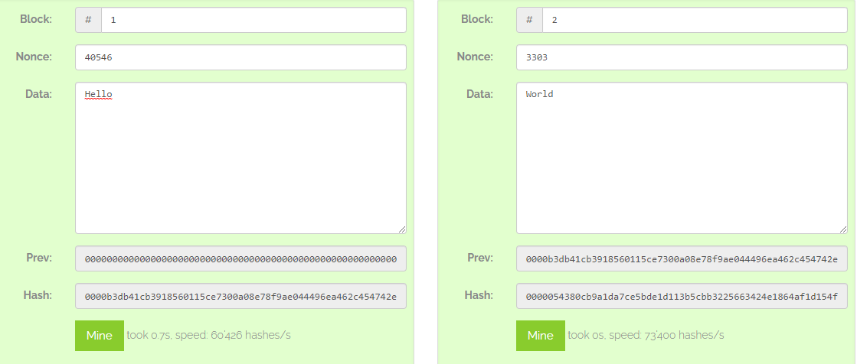
How blocks system working

Slide 10
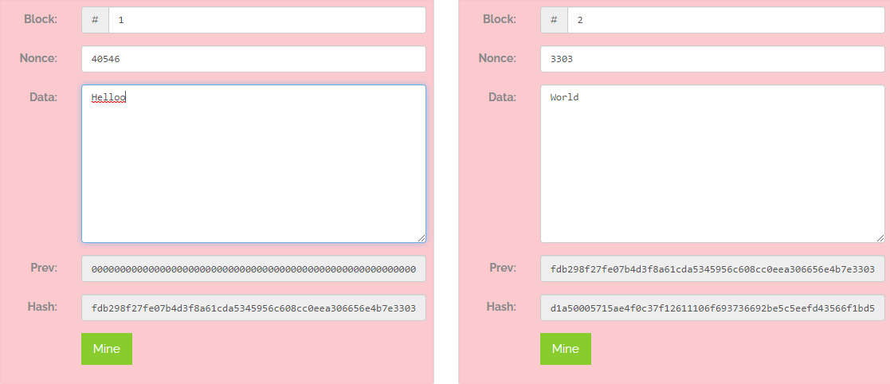
Any change in previous blocks breaks the whole chain

Slide 11
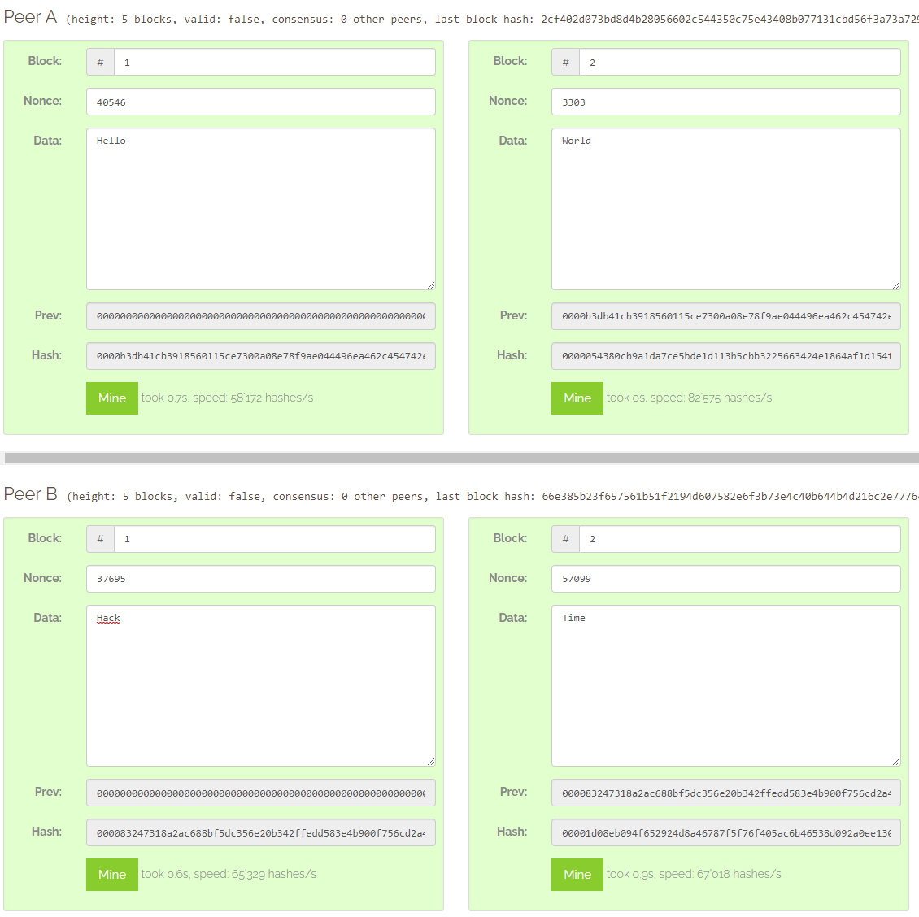
Distributed system

Slide 12
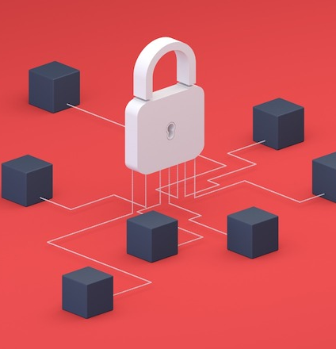
Cryptography In Blockchain Supheli
Cryptography and hashing are key components of blockchain technology. Cryptography is used to secure data and transactions through mathematical algorithms, while hashing is used to create unique digital fingerprints of data. In a blockchain network, cryptography creates secure communication channels and digital signatures, while hashing ensures the integrity of data and transactions. These techniques play a critical role in ensuring the security, integrity, and trust of blockchain networks

Slide 13
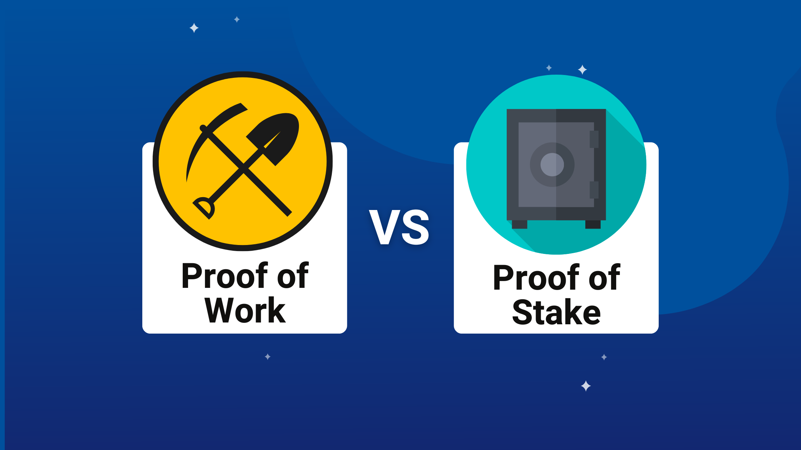
Mining Methods
Proof of Work (PoW) and Proof of Stake (PoS) are two different methods used to validate transactions in a blockchain network. PoW requires miners to perform complex calculations to solve a cryptographic puzzle in order to add a new block to the chain. This process is energy-intensive and requires expensive hardware. In contrast, PoS allows block validators to create new blocks based on their stake in the network, rather than computational power. This method is less energy-intensive and requires less hardware. However, PoS introduces the possibility of centralization, as those with the most stake have more power in the network.

Slide 14
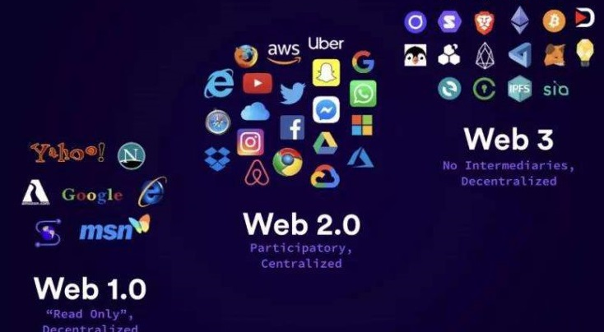
Web3.0
Web3, also known as the decentralized web, is the next evolution of the internet that aims to enable peer-to-peer interactions without relying on centralized intermediaries. Web3 technologies, such as blockchain, smart contracts, and decentralized applications (dApps), allow for the creation of trustless and transparent digital ecosystems. With web3, users can control their data, identities, and digital assets without relying on third parties, and developers can create new types of decentralized applications that are not possible with traditional web technologies.

Slide 15

Cryptocurrency
Cryptocurrency is a digital or virtual currency that uses cryptography for security. It operates independently of a central bank and is decentralized, meaning that it is not controlled by any single entity or government. The first cryptocurrency, Bitcoin, was created in 2009 by an unknown person or group using the pseudonym Satoshi Nakamoto. Since then, thousands of other cryptocurrencies have been created, each with its own unique features and use cases.

Slide 16
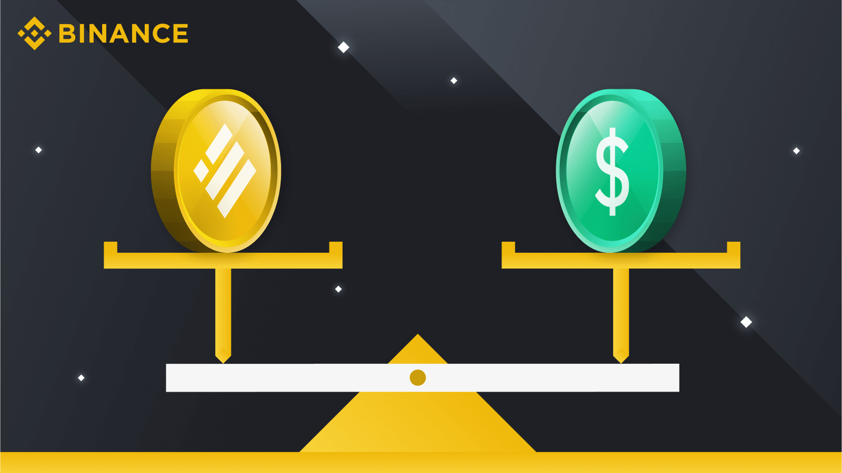
Stable Coins
Stablecoins are a type of cryptocurrency that is designed to have a stable value. Unlike other cryptocurrencies, which can have highly volatile prices, stablecoins are often pegged to the value of a specific asset, such as the US dollar, euro, or gold. This stability makes stablecoins more suitable for use as a medium of exchange or a store of value. There are different types of stablecoins, including fiat-backed, crypto-backed, and algorithmic stablecoins.

Slide 17

NFT
NFT stands for non-fungible token, which is a unique digital asset that represents ownership of a particular item or piece of content. NFTs are built on blockchain technology, which allows for secure and transparent ownership and transfer of digital assets. NFTs can be used to represent a wide range of digital content, such as art, music, videos, and even tweets. Unlike traditional cryptocurrencies, NFTs are non-fungible, meaning that each one is unique and cannot be replaced by another token of the same value. This has led to a growing market for NFTs, with some selling for millions of dollars.

Slide 18

Wallets
In blockchain technology, a wallet is a digital tool used to manage and store digital assets, such as cryptocurrencies or NFTs. Blockchain wallets can be accessed through private keys, which are used to sign transactions and verify ownership of digital assets. There are different types of blockchain wallets, including physical wallets or hardware wallets. These wallets store the private keys in a secure environment, disconnected from the internet, which makes them less vulnerable to hacking and theft. Blockchain wallets allow for secure and convenient storage and transfer of digital assets, and are a key component of the blockchain ecosystem.

Slide 19
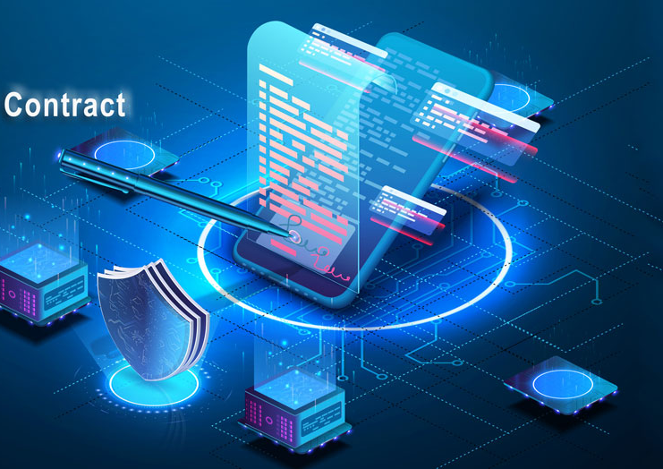
Smart Contracts
Smart contracts are computer programs that enable the execution of complex agreements between parties in a transparent and secure manner. They operate on a decentralized blockchain network and can be used for a wide range of applications, from financial transactions and digital identity verification to supply chain management and intellectual property rights. Smart contracts offer several benefits over traditional contracts, such as increased efficiency, reduced costs, and improved transparency, and have the potential to revolutionize various industries.

Slide 20
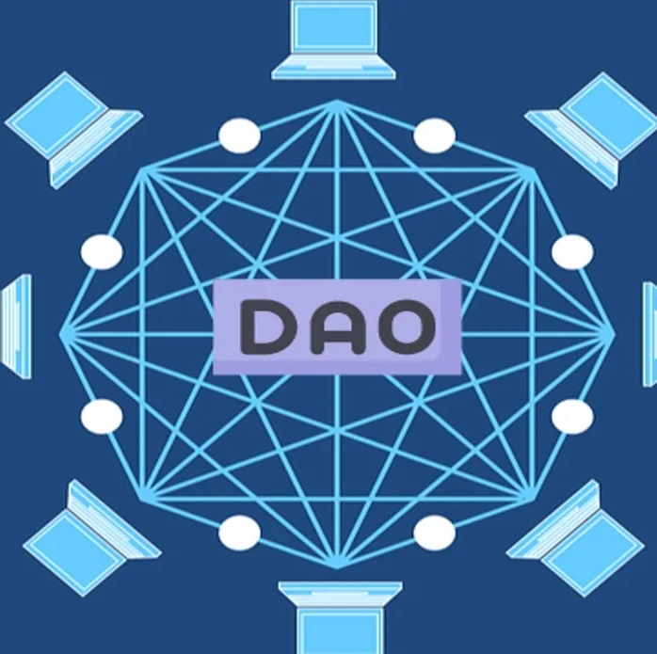
DAO
Decentralized Autonomous Organizations (DAOs) uses blockchain technology to operate autonomously without the need for intermediaries. They are controlled by smart contracts and governed by their members, who have voting rights on key decisions. DAOs have the potential to provide more transparency, accountability, and democratization in decision-making processes.

Slide 21
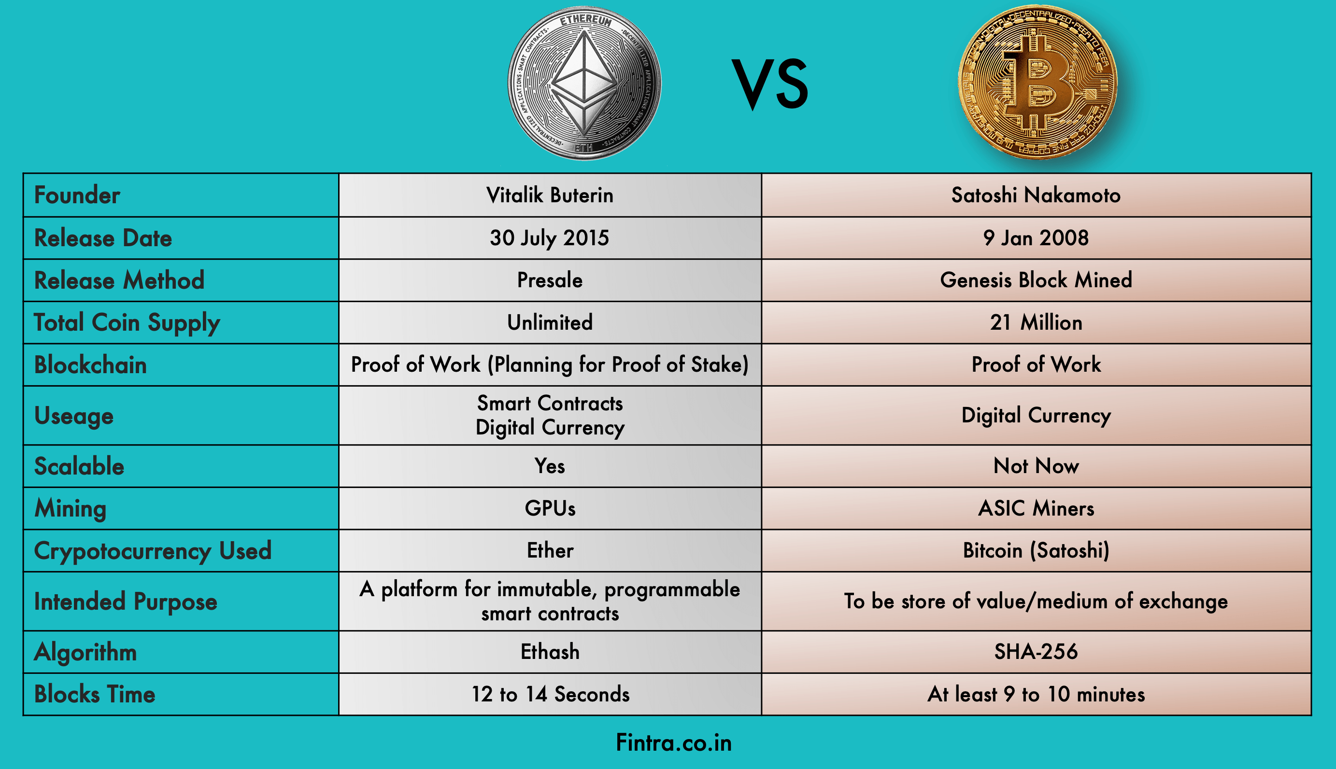
Blockchain platforms
Ethereum and Bitcoin have some differences in their design and functionality. While Bitcoin was designed as a digital currency, Ethereum was created as a decentralized platform for building applications using smart contracts. Ethereum has its own programming language, Solidity, which allows developers to create custom smart contracts. Bitcoin, on the other hand, has a limited scripting language that is used mainly to transfer funds. Additionally, Ethereum has faster block times and lower transaction fees compared to Bitcoin.

Slide 22
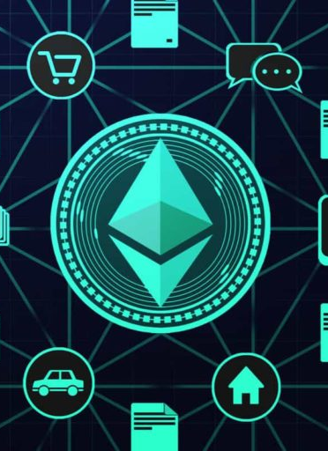
Dapp
Decentralized applications (Dapps) are applications built on top of a blockchain network that operate in a decentralized manner, meaning they don't rely on a central authority to function. Instead, they use the blockchain's consensus mechanism to validate transactions and maintain the network. Dapps are designed to be open source, transparent, and immutable, which makes them resistant to censorship and hacking attempts. They often utilize smart contracts to automate processes and ensure trust between parties.

Slide 23
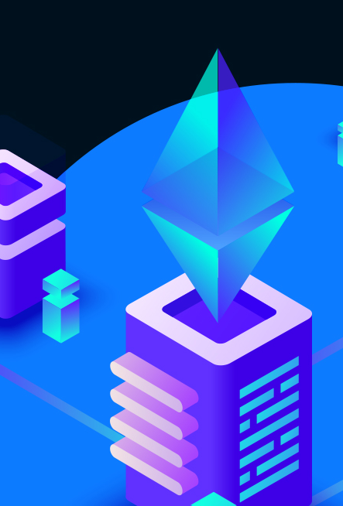
EVM
EVM stands for Ethereum Virtual Machine, which is a runtime environment that executes smart contracts written in Ethereum's programming language, Solidity. EVM is designed to be completely deterministic and Turing-complete, meaning it can execute any arbitrary computation. EVM is responsible for the state transition function in Ethereum, which updates the blockchain with the results of the executed smart contracts. It ensures that all nodes on the network have the same result of executing the same smart contract, and the result is predictable and secure.

Slide 24

Limitations of Blockchain
-Energy consumption
-Scalability:Every device in network must have copy of every transaction = massive storage
-Regulation: Decentralization of authority
-> No moderators , laws or leaders.
-Cost:Any transaction on blockchain has cost.
-It is complex to understand and adopt .

Slide 25

Where to Use Blockchain
Blockchain can be used in various industries where security, transparency, and decentralization are crucial. For example, voting systems can benefit from blockchain by ensuring secure and transparent elections. Supply chain management can use blockchain to track the movement of goods and verify their authenticity. Crowdfunding can leverage blockchain to provide a decentralized platform for fundraising campaigns.

Slide 26
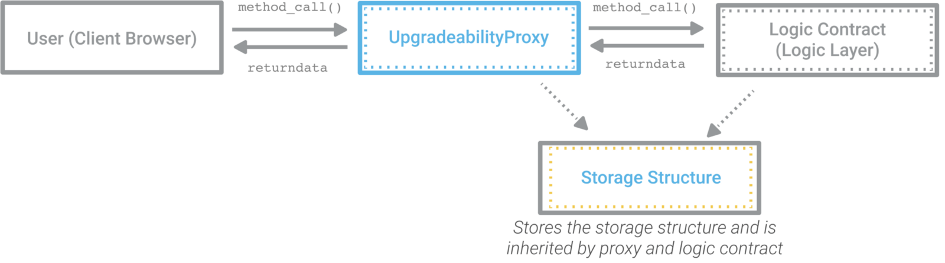
Proxy Contracts
Proxy contracts are advanced smart contracts that allow for the upgrading of other contracts on the blockchain. They act as a layer of indirection between the user and the contract they wish to interact with, enabling the contract owner to modify the code of their contract without disrupting the existing interactions and state of the contract. This is particularly useful for contracts that are intended to be long-lived and require updates over time.

Slide 27
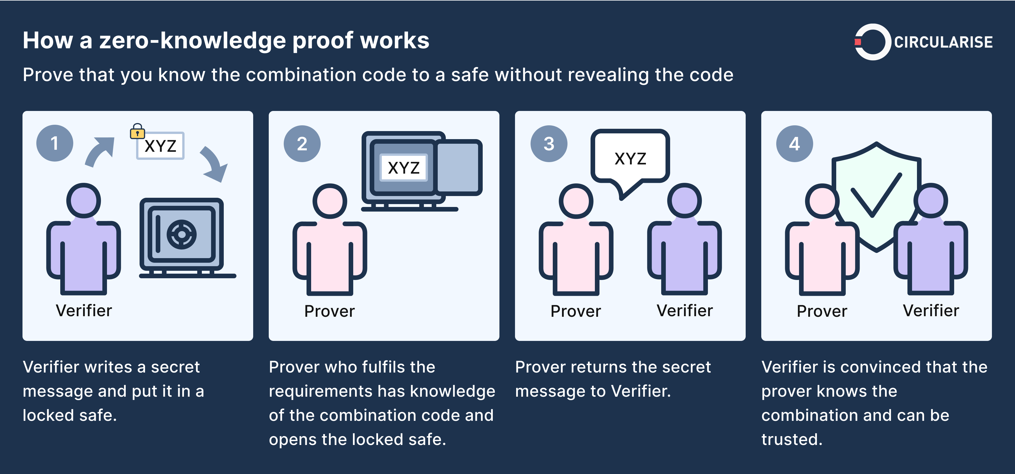
Zero Knowladge Proof
Zero-knowledge proof (ZKP) is a cryptographic method that allows a prover to convince a verifier that a statement is true without revealing any information beyond the statement's validity. This technology has been widely used in blockchain applications to enhance privacy and security. ZKPs are particularly useful in decentralized finance (DeFi) applications, where users want to maintain privacy and security while making transactions. They can also be used for identity verification, ensuring that sensitive personal information is not disclosed unnecessarily.

Slide 28
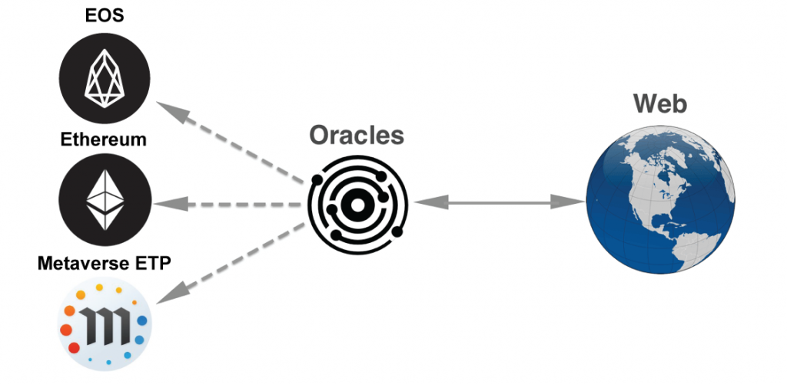
Oracles
Blockchain oracles are services that allow smart contracts to interact with external data sources, enabling them to perform functions based on real-world information. These oracles act as a bridge between the on-chain and off-chain worlds, providing secure and reliable data to the smart contract. The data is verified and validated by the oracle, which ensures that it cannot be tampered with.

Slide 29
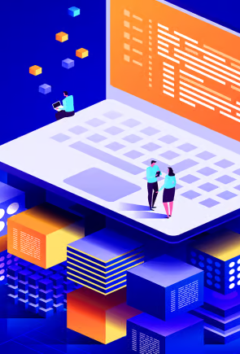
How to become a blockchain developer
Being a blockchain developer requires a unique set of skills and knowledge. First and foremost, developers must have a strong foundation in programming languages such as Solidity, JavaScript, and Python. Additionally, developers should have an understanding of distributed systems, cryptography, and smart contract development. Familiarity with blockchain platforms such as Ethereum and Bitcoin is also important. Developers must also stay up to date with the latest trends and technologies in the blockchain space.

Slide 30
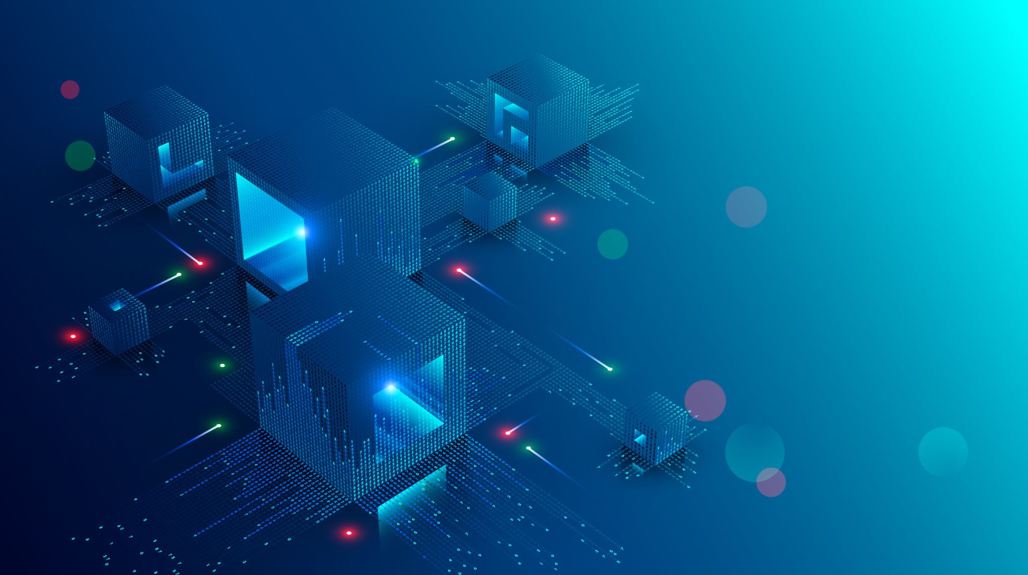
Further Resources
https://www.youtube.com/@PatrickAlphaC
https://www.youtube.com/@austingriffith3550/videos
https://www.youtube.com/@Web3_Club
https://www.youtube.com/@freecodecamp
https://www.youtube.com/@CagatayAkkas
https://medium.com/@CagatayAkkas

Slide 31
Even Further Resources
Blockchain simulation : https://guggero.github.io/blockchain-demo/#!/blockchain
Roadmap: https://medium.com/gs-developer-community/solidity-roadmap-2023-f9c43c659452
Tx.street : https://txstreet.com/v/eth-btc
Ethernaut : https://ethernaut.openzeppelin.com/level/0x40055E69E7EB12620c8CCBCCAb1F187883301c30
MetaMask : https://chrome.google.com/webstore/detail/metamask/nkbihfbeogaeaoehlefnkodbefgpgknn
Recomended Course : https://www.youtube.com/watch?v=gyMwXuJrbJQ
Remix IDE : https://remix.ethereum.org/

